Slide 1


Scientific Machine Learning
Lecture 1: Introduction
孟旭辉
数学与统计学院数学与应用学科交叉创新研究院
办公室：欣苑2栋111室
Email：xuhui_meng@hust.edu.cn
3/8/2024

Slide 2
课程考核方式
64学时
平时成绩50% + 结课论文50%
平时成绩
课程要求：编程Python/Julia/Jax…
4-5次课后作业

Slide 3
Contents
Artificial Intelligence (AI) – Machine Learning – Deep Learning
Recent Progress on Deep Learning
Scientific Machine Learning – AI for Science (AI4Science)

Slide 4
Contents
Artificial Intelligence (AI) – Machine Learning – Deep Learning
Recent Progress on Deep Learning
Scientific Machine Learning – AI for Science (AI4Science)

Slide 5
Artificial Intelligence – Machine Learning – Deep Learning
人工智能（artificial intelligence，缩写为AI）亦称智械、机器智能，指由人制造出来的机器所表现出来的智能。通常人工智能是指通过普通计算机程序来呈现人类智能的技术。
机器学习是人工智能的一个分支。 机器学习是实现人工智能的一个途径之一，即以机器学习为手段，解决人工智能中的部分问题。
深度学习（deep learning）是机器学习的分支，是一种以人工神经网络为架构，对资料进行表征学习的算法。

Slide 6
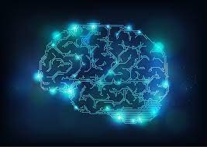
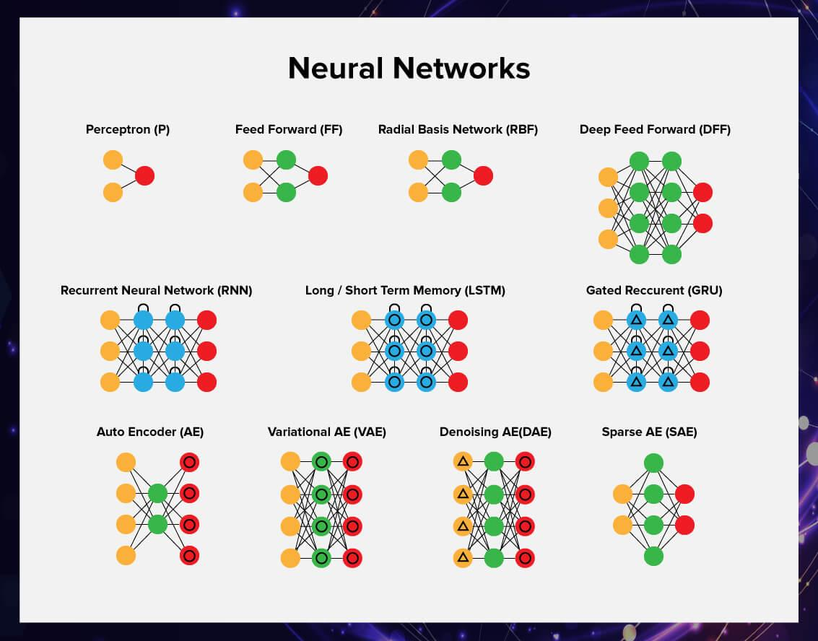
深度学习
深度学习（英语：deep learning）是机器学习的分支，是一种以人工神经网络为架构，对资料进行表征学习的算法
深度学习框架，如深度神经网络、卷积神经网络和深度置信网络和循环神经网络已被应用在计算机视觉、语音识别、自然语言处理、音频识别与生物信息学等领域并取得了极好的效果

Slide 7

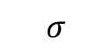
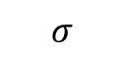
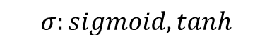
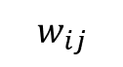
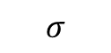
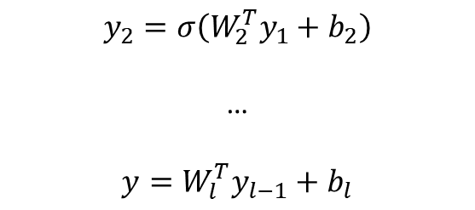
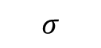
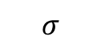

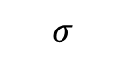
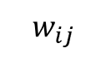
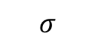
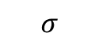
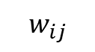
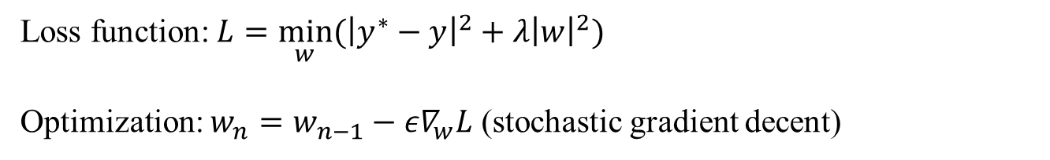
Deep Neural Networks (DNNs): Universal Approximation Theorem
$$w_{ij}$$
$$w_{ij}$$
$$σ$$
$$σ$$
$$w_{ij}$$
$$y_{1}=σ(W_{1}^{T}x+b_{1})$$
$$σ$$
$$σ$$
$$y_{2}=σ\left(W_{2}^{T}y_{1}+b_{2}\right)$$
…
$$y=W_{l}^{T}y_{l−1}+b_{l}$$
y
$$σ$$
$$σ$$
$$σ$$
$$σ$$
$$σ:sigmoid, tanh$$
Standard multilayer feedforward networks are capable of approximating any measurable function to any desired degree of accuracy
Convergence rate increases as the number of hidden units grows
Loss function: $L={\min_{w}⁡(\left|y^{∗}−y\right|}^{2}+λ{\left|w\right|}^{2})$
Optimization: $w_{n}=w_{n−1}−{ε∇}_{w}L$ (stochastic gradient decent)
Hornik, et al, Neural Networks, 1989

Slide 8
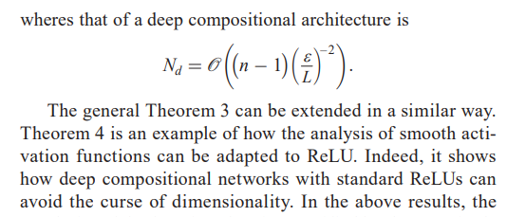
Deep Neural Networks (DNNs): Curse of Dimensionality
$$w_{ij}$$
$$w_{ij}$$
$$σ$$
$$σ$$
$$w_{ij}$$
$$y_{1}=σ(W_{1}^{T}x+b_{1})$$
$$σ$$
$$σ$$
$$y_{2}=σ\left(W_{2}^{T}y_{1}+b_{2}\right)$$
…
$$y=W_{l}^{T}y_{l−1}+b_{l}$$
y
$$σ$$
$$σ$$
$$σ$$
$$σ$$
$$σ:sigmoid, tanh$$
Poggio, et al, 2018

Slide 9
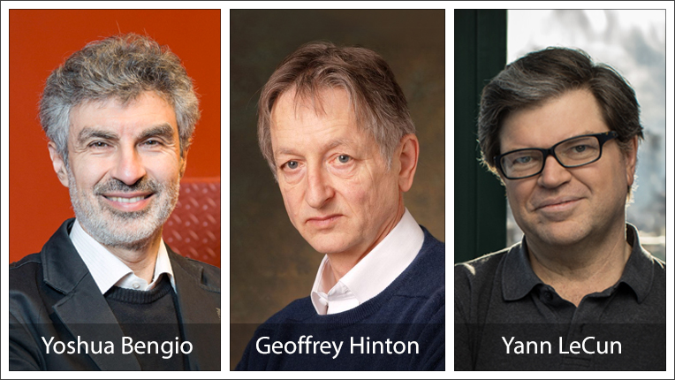
2018 Turing Award
"Deep neural networks are responsible for some of the greatest advances in modern computer science, helping make substantial progress on long-standing problems in computer vision, speech recognition, and natural language understanding. At the heart of this progress are fundamental techniques developed starting more than 30 years ago by this year's Turing Award recipients, Yoshua Bengio, Geoffrey Hinton, and Yann LeCun. By dramatically improving the ability of computers to make sense of the world, deep neural networks are changing not just the field of computing, but nearly every field of science and human endeavor.”
-- Jeff Dean

Slide 10
Contents
Artificial Intelligence (AI) – Machine Learning – Deep Learning
Recent Progress on Deep Learning
Scientific Machine Learning – AI for Science (AI4Science)

Slide 11

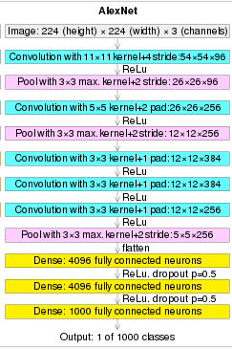
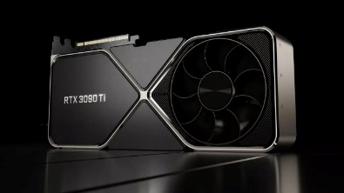
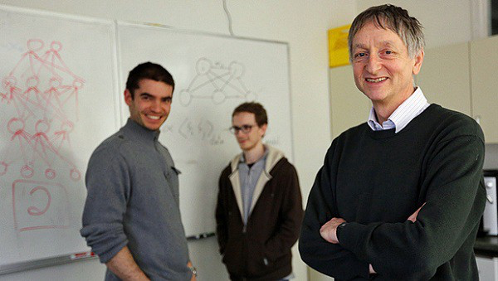
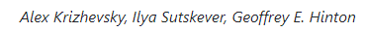
Recent Progress on DL: AlexNet
Feifei Li, Sandford University
ImageNet
AlexNet参加了2012年9月30日举行的ImageNet大规模视觉识别挑战赛，达到最低的15.3%的Top-5错误率，比第二名低10.8个百分点
神经网络深度对模型性能提升至关重要
GPU加速计算

Slide 12

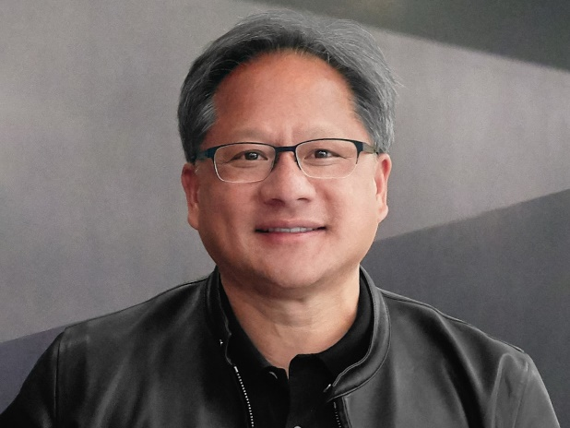
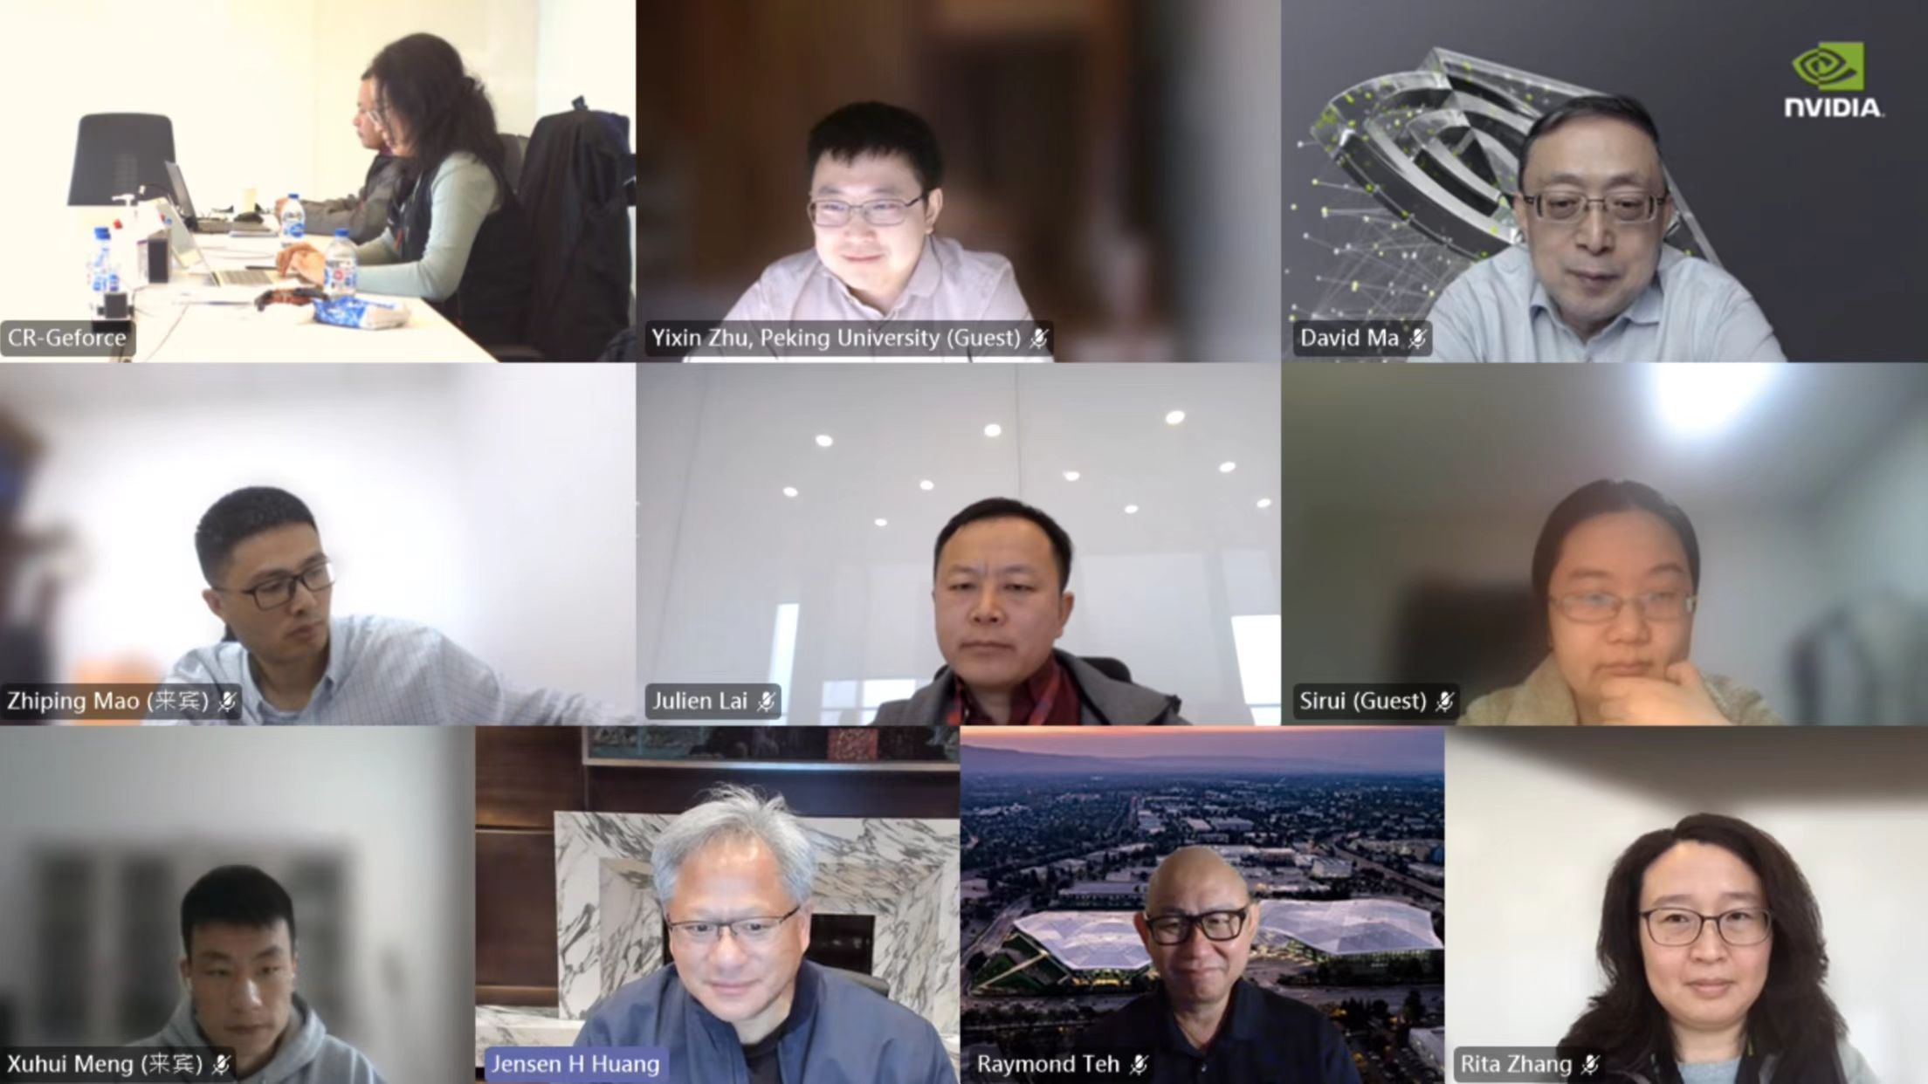
Recent Progress on DL: AlexNet
Jenson Huang
（黄仁勋）

Slide 13
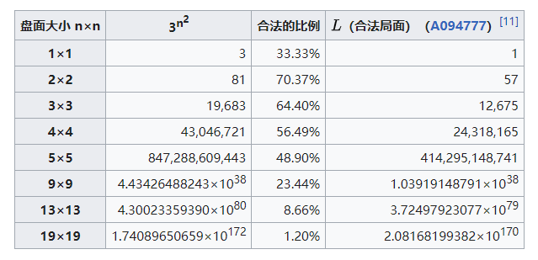
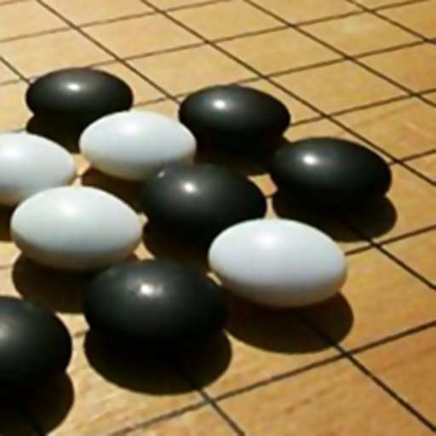
Recent Progress on DL: DeepMind - Alphago

Slide 14
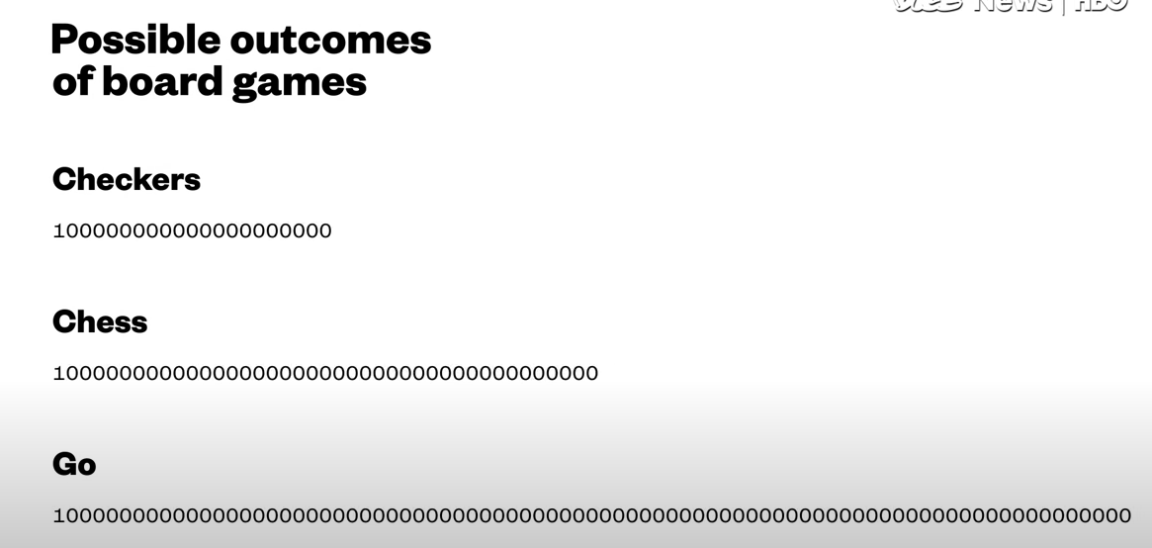

Recent Progress on DL: DeepMind - Alphago
64位系统寻址空间: $2^{64}$
可观测宇宙包含的原子数目：大约${10}^{80}$个

Slide 15
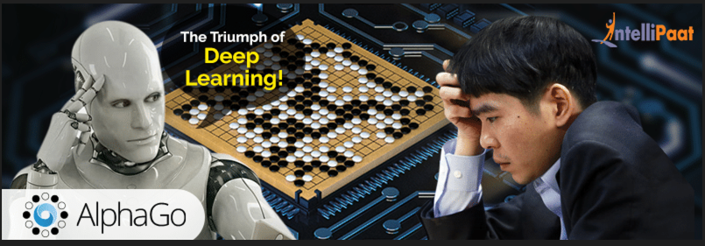
Recent Progress on DL: DeepMind - Alphago
14次世界冠军
18个国际大赛冠军
冠军数围棋史排名第二

Slide 16
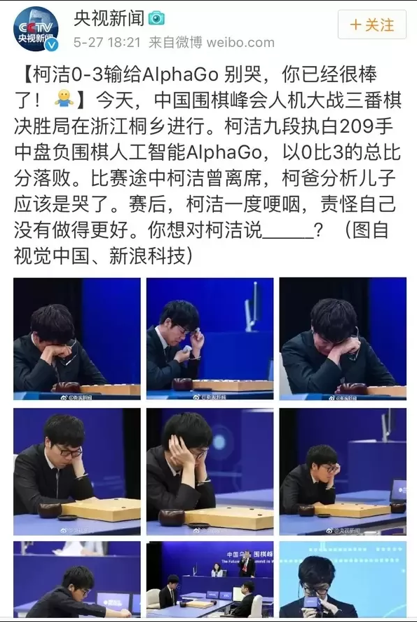
Recent Progress on DL: Alphago ->Alphazero

Slide 17
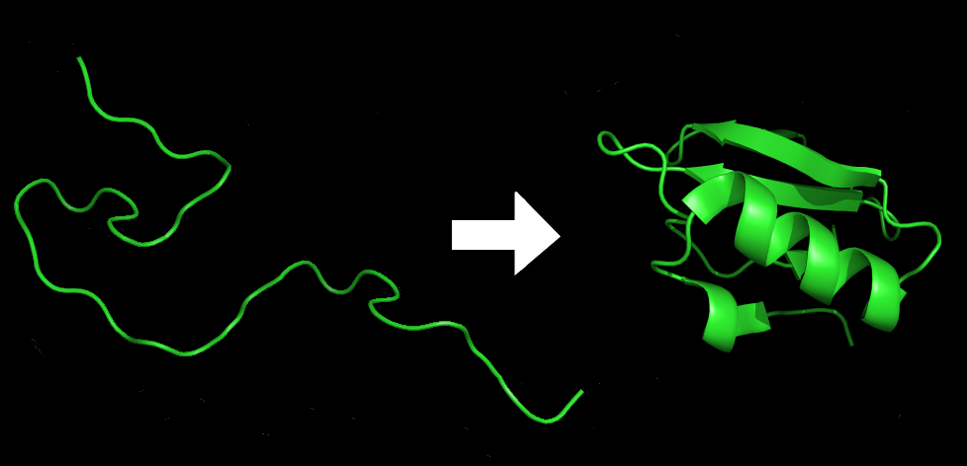
Recent Progress on DL: DeepMind - Alphafold
蛋白質的功能取決於其立體結構
蛋白质折叠（Protein folding）是蛋白质获得其功能性结构和构象的物理过程。通过这一物理过程，蛋白质从无规则卷曲折叠成特定的功能性三维结构。在从mRNA序列翻译成线性的氨基酸链时，蛋白质都是以去折叠多肽或无规则卷曲的形式存在。
安芬森法则：蛋白质分子的一级结构决定其立体结构
已知某基因序列可翻译获得对应蛋白质的胺基酸序列，即蛋白质的一级结构
基因序列 – 蛋白质三维结构 – 蛋白质功能

Slide 18
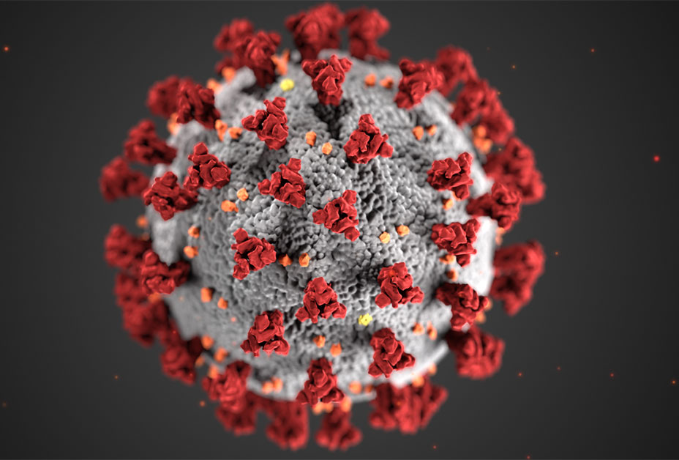
Recent Progress on DL: Alphafold
灭活/减活疫苗
mRNA疫苗

Slide 19
Recent Progress on DL: Alphafold
所有生命形式中已知蛋白质超过2亿种, 过去60年努力只确定了约170,000种蛋白质结构
蛋白质结构预测技术的关键测试(CASP)-起源于1994年，每两年一次
到2016年的蛋白质发现GDT分数也只能达到100满分的40分
2018年 – Alphafold: 68.5
2020年 - Alphafold2: 92.4

Slide 20
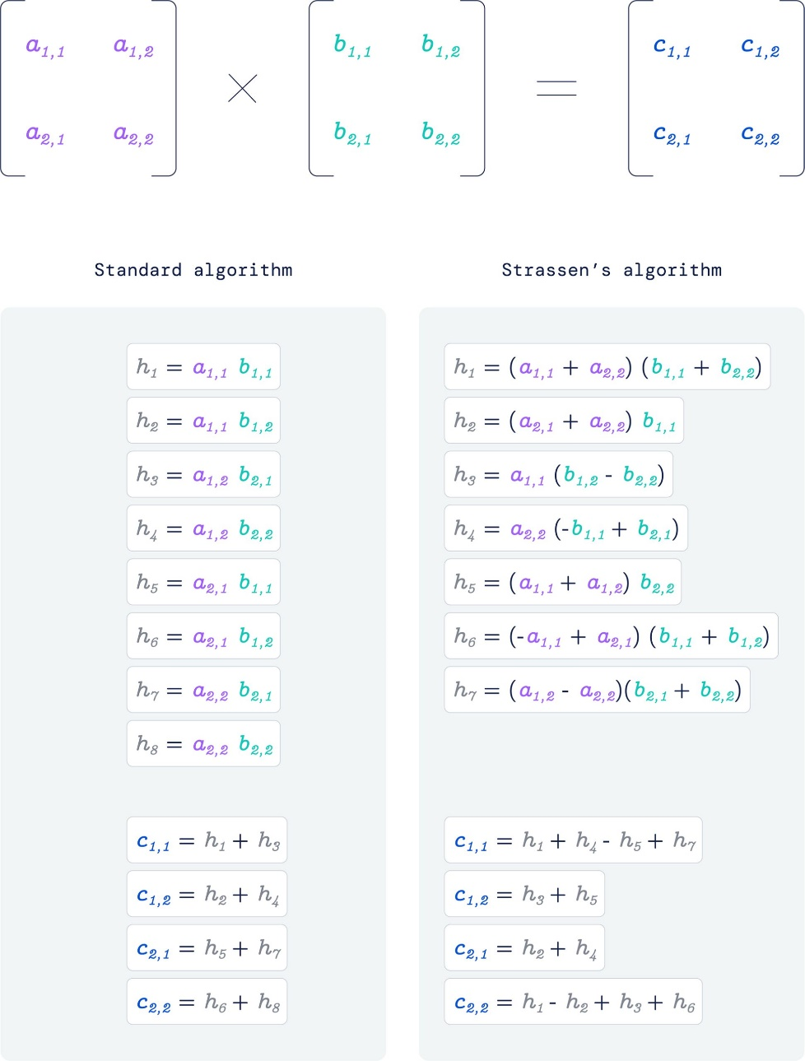
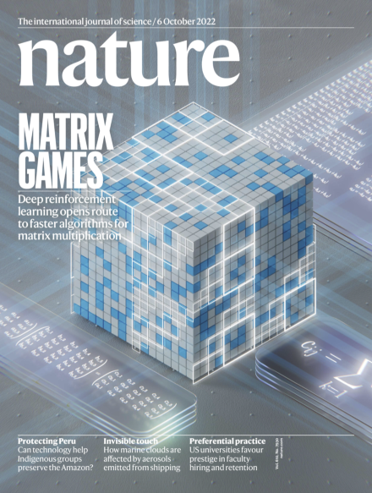
Recent Progress on DL: DeepMind

Slide 21
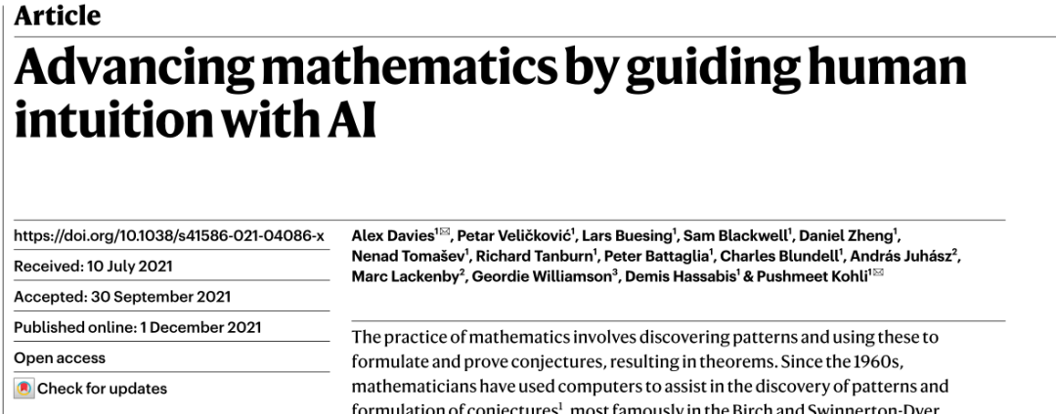
Recent Progress on DL: DeepMind

Slide 22

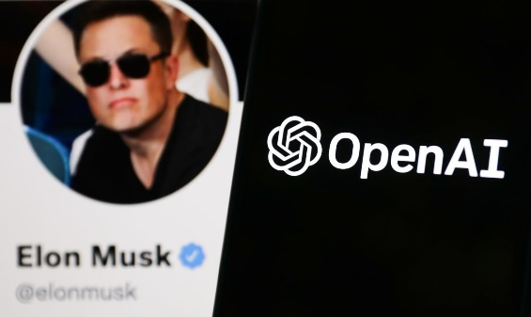
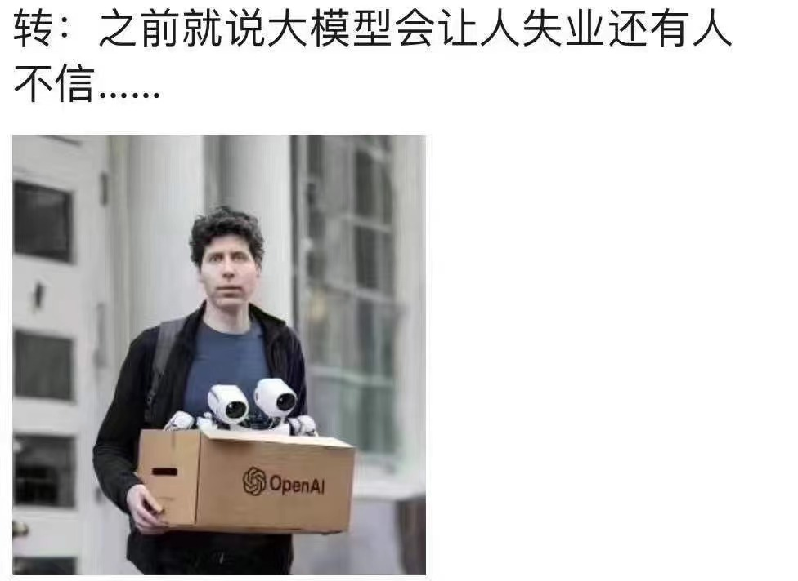
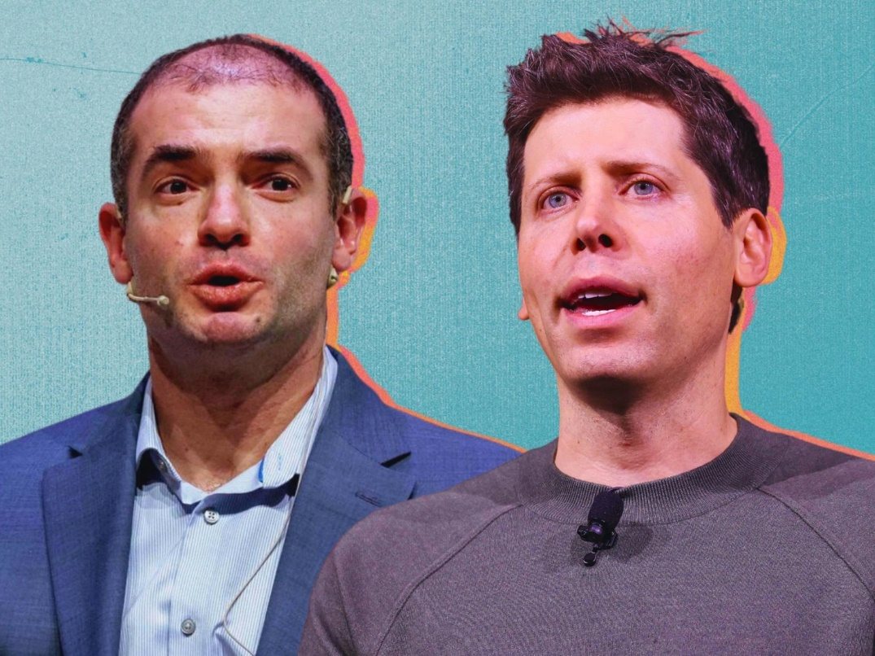
OpenAI-Chatgpt

Slide 23
Contents
Artificial Intelligence (AI) – Machine Learning – Deep Learning
Recent Progress on Deep Learning
Scientific Machine Learning – AI for Science (AI4Science)

Slide 24
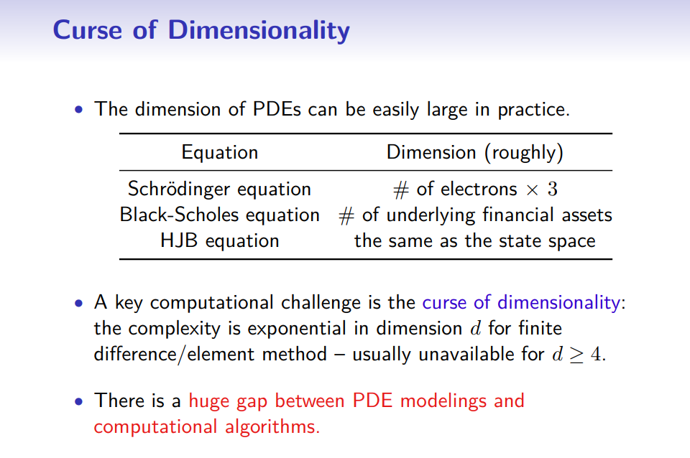
SciML: Solving high-dimensional PDEs
J. Han: http://cmx.caltech.edu/ipml/ipml-slides-han.pdf

Slide 25
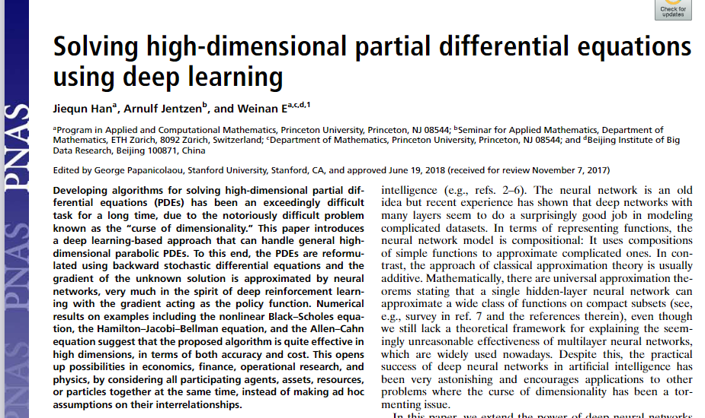
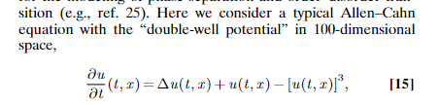
SciML: Solving high-dimensional PDEs
100D Allen-Cahn equation

Slide 26
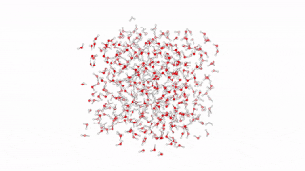
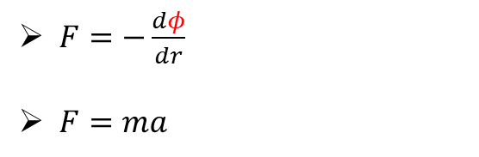
SciML: DeepPotential
$F=−\frac{dφ}{dr}$
$F=ma$
现有作用力模型往往基于经验公式
只考虑近程作用力
只考虑二体或三体作用，不考虑多体作用
…

Slide 27
SciML: DeepPotential
$F=−\frac{dφ}{dr}$
$F=ma$
$$σ$$
$$σ$$
$$σ$$
$$σ$$
$$σ$$
$$σ$$
$$σ$$
$$σ$$

Slide 28
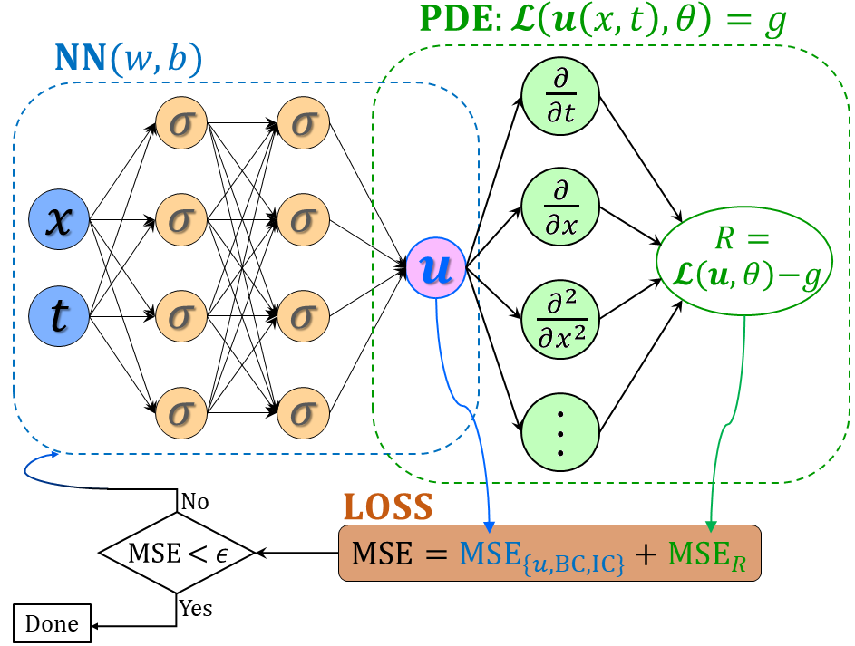
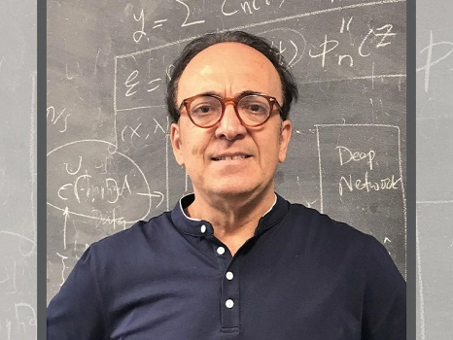
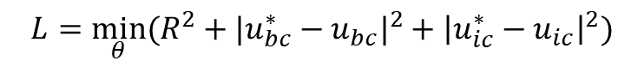

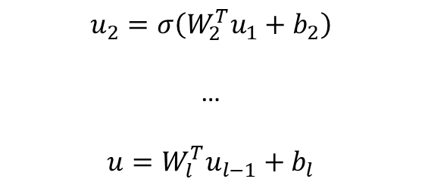

SciML: Solving Forward/Inverse PDEs
$$u_{1}=σ(W_{1}^{T}X+b_{1})$$
(1)
$$u_{2}=σ\left(W_{2}^{T}u_{1}+b_{2}\right)$$
…
$$u=W_{l}^{T}u_{l−1}+b_{l}$$
G. Karniadakis
(2) PDE part: Chain rule
$$∂_{t}u, ∂_{x}u, …$$
Physics-informed neural networks (PINNs)
Loss function:
Forward problem:
$$L={\min_{θ}⁡(R^{2}+|u_{bc}^{∗}−u_{bc}|}^{2}+{\left|u_{ic}^{∗}−u_{ic}\right|}^{2})$$
Inverse problem:
$$L={\min_{θ,λ}⁡(R^{2}+|u_{bc}^{∗}−u_{bc}|}^{2}+{\left|u_{ic}^{∗}−u_{ic}\right|}^{2}+{\left|u^{∗}−u\right|}^{2})$$
Raissi, et al, JCP, 2019
Meng, et al, CMAME, 2020

Slide 29
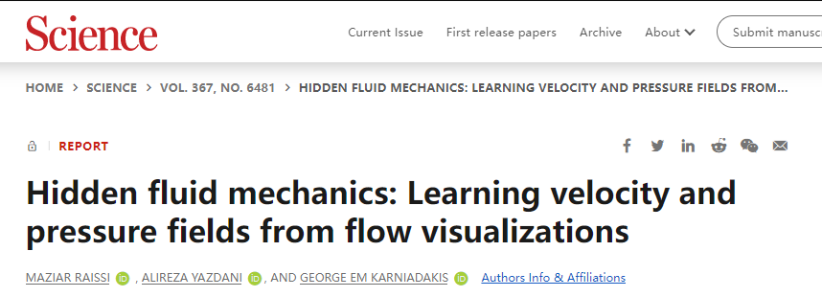
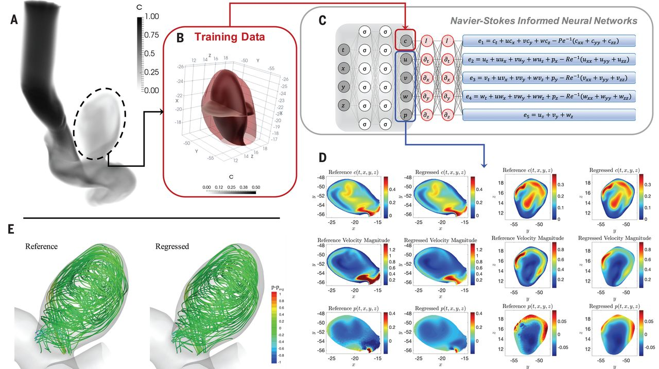
SciML: Solving Forward/Inverse PDEs

Slide 30
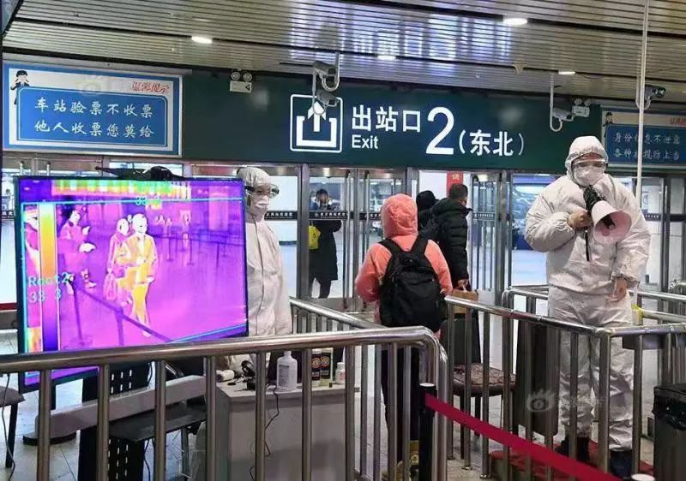
SciML: Solving Forward/Inverse PDEs

Slide 31
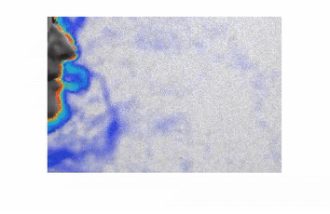


SciML: Solving Forward/Inverse PDEs
Does Mask matter: https://www.youtube.com/watch?v=kYJvU81DKgk
Cai et al., Gallery of Fluid Motion - APS DFD meeting, 2020

Slide 32



SciML: Discovering governing equations from data

Slide 33






SciML: Theory development

Slide 34

Thank you for your attention!

